Slide 1
McLean County Chamber of Commerce
Good Energy, LP
Business Education, June 2022
Energy Management: How to Navigate Increasing Electricity Prices
June 2, 2022

Slide 2
Overview
Greetings!
Introductions
Energy 101
Market discussion
McLean County Chamber Energy Program

Slide 3
Energy 101
IL is a deregulated energy market
Ameren (utility) maintains the poles and wires (distribution)
no financial interest on the supply side
consistent service, supplier independent
Suppliers provide electricity, even for Ameren default service
Customers have the choice who supplies their electricity
Supply of electricity has several components
Commodity - purchased on forward or index markets
Capacity - grid reliability, annual auction
Natural gas supply is driven by market dynamics

Slide 4
Market Overview
The MISO Planning Resource Auction (capacity) reached the price ceiling of $236.66 per MW-day. The 2021/22 price was $5.00 per MW-day.
This result, which shocked the market, significantly increases costs of serving load in Illinois.
Commodity energy prices are currently volatile and rising significantly.
Natural gas is affected by world economics
Suppliers have become risk averse about making forward commitments

Slide 5
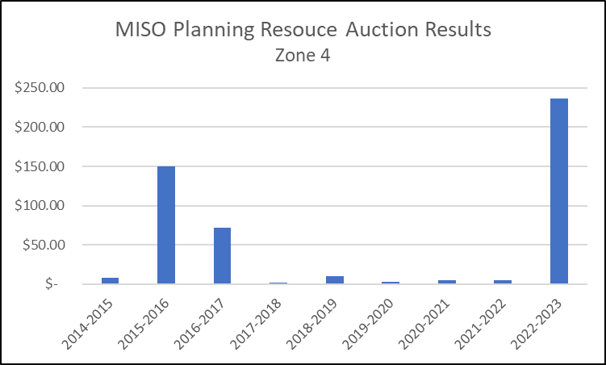
MISO Planning Resource Auction History

Slide 6
Future Contract Prices—Annual Strips

Slide 7
Forward Power Markets

Slide 8
New Tariff Supply Rates: June 1, 2022 - May 31, 2023
Summer Rate (June 2022 - September 2022) – 12.22 ¢/kWh
Non-Summer Rate (October 2022 - May 2023) – 13.981 ¢/kWh
Weighted average annualized tariff rate - 13.329 ¢/kWh
2021-2022 avg rate was 5.78¢/kWh
~130% increase for supply of electricity

Slide 9
McLean County Chamber Energy Program
Electricity
Leverage combined buying power of Chamber members
Optimize timing of procurement & term length
Custom pricing when needed
Natural Gas
New participants must leave Ameren pool in the winter of each year
Existing 3rd party Natural Gas customers can renew at any time
Demand Response*
Get paid for curtailing demand during peak load events
*Currently only applies to very large consumers of electricity
Renewable Energy
Create sustainability strategy for members with ESG goals

Slide 10
McLean County Chamber Energy Program
Annual Evaluation
Review current bills to discover opportunities
Qualify accounts for participation in each program
Create buying groups for mutual benefit
Jerod McMorris Gary Swantner
309.369.6352 505.453.6420
jerod@goodenergy.com gary.swantner@goodenergy.com

